Slide 1
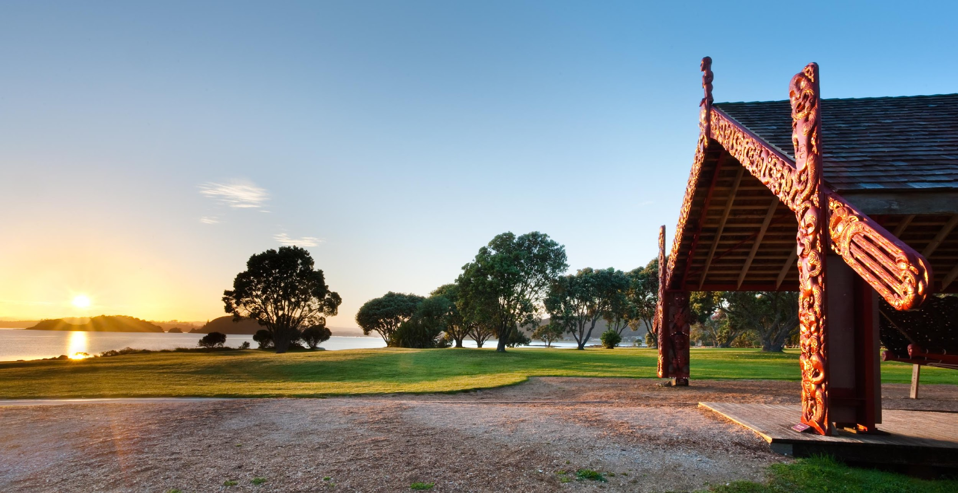

Slide 2
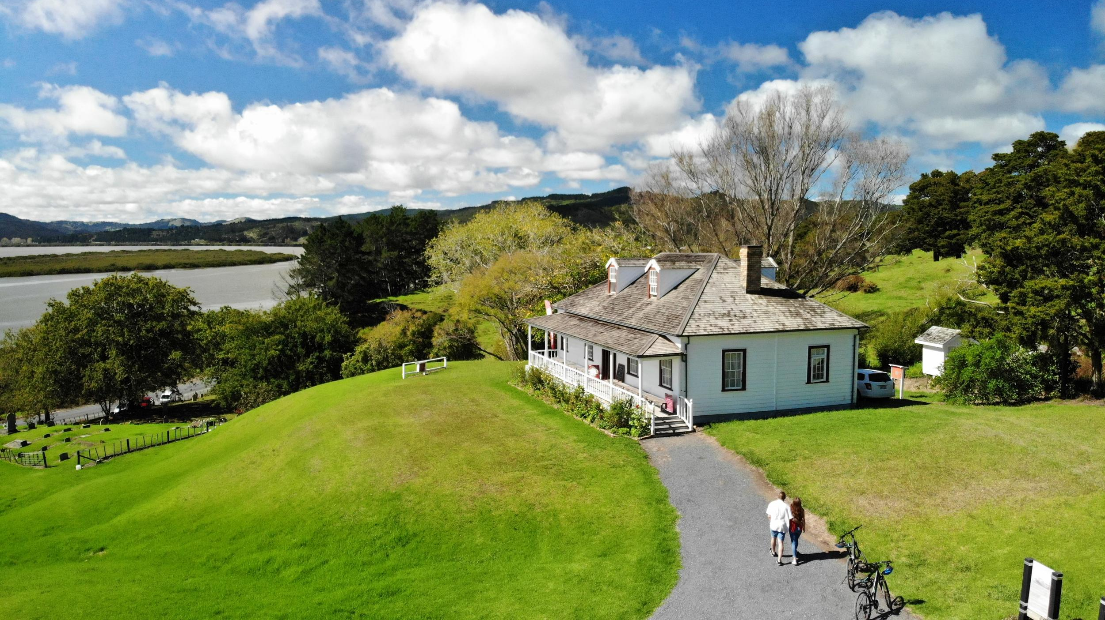
Tohu Whenua is a visitor programme that connects New Zealanders with their heritage and enhances their sense of national identity by promoting significant historical and cultural sites.
Notes:
What is Tohu Whenua?
Tohu Whenua is a visitor programme that connects New Zealanders with their heritage and enhances their sense of national identity.
Tohu Whenua does this by promoting significant heritage and cultural sites that helped shape our nation’s story.

Slide 3
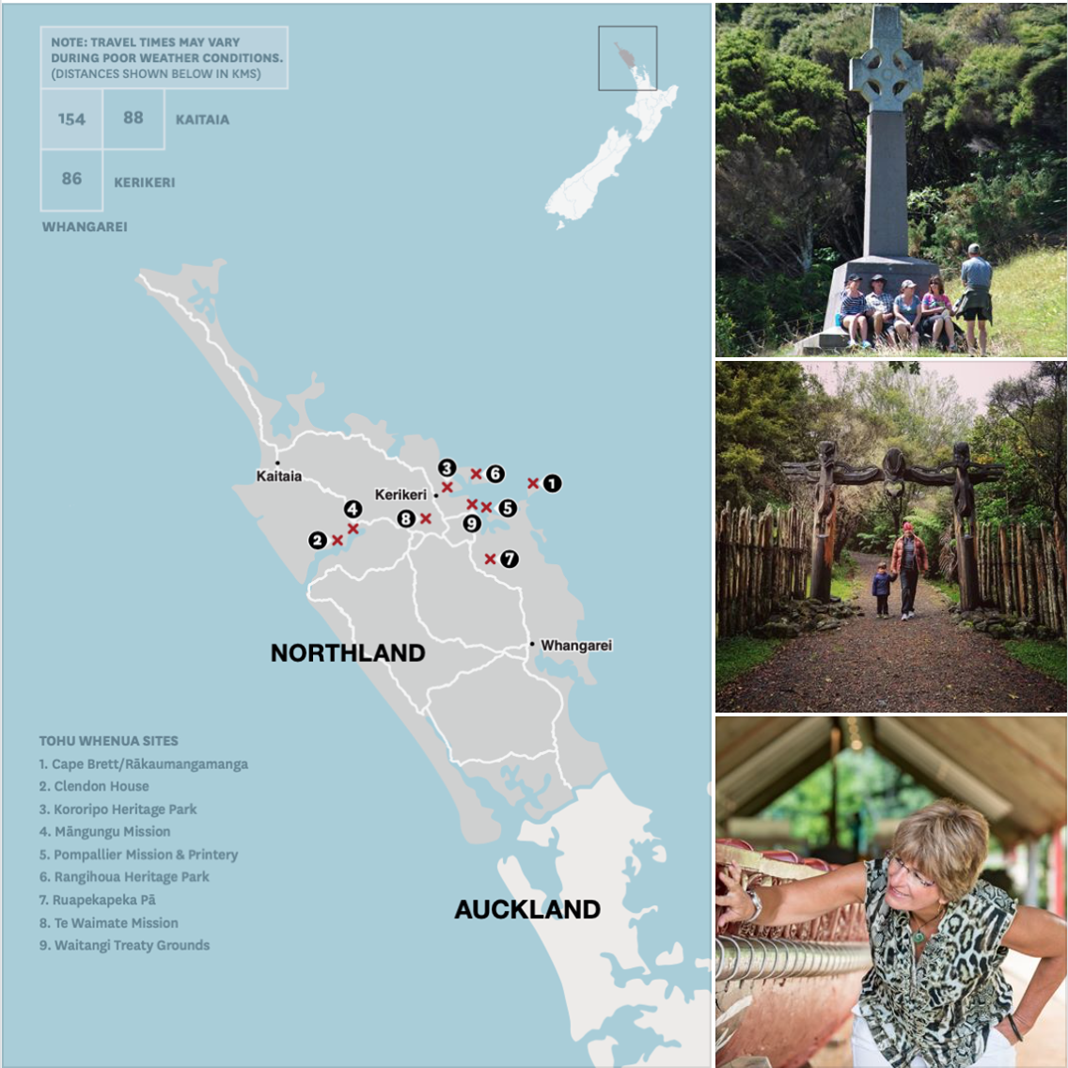
Tohu Whenua promotes a network of selected heritage places called Tohu Whenua (te reo Māori for landmarks).
This makes it easy for visitors to identify our nation’s best heritage experiences.
Notes:
Tohu Whenua’s strength is that it forms a network of heritage sites that have been selected as being Aotearoa New Zealand’s best heritage experiences. By being connected under one brand, visitors can easily identify heritage sites around the country that provide a high and dependable level of heritage experience.
Tohu Whenua is both the name of the programme as well as the places that are recognised by the programme. Tohu Whenua is translated as ‘landmarks’ in te reo Māori
We hope that the Tohu Whenua brand will become as recognisable as, for example, the Great Walks brand.
Ultimately, this will mean more people visiting Tohu Whenua places.

Slide 4
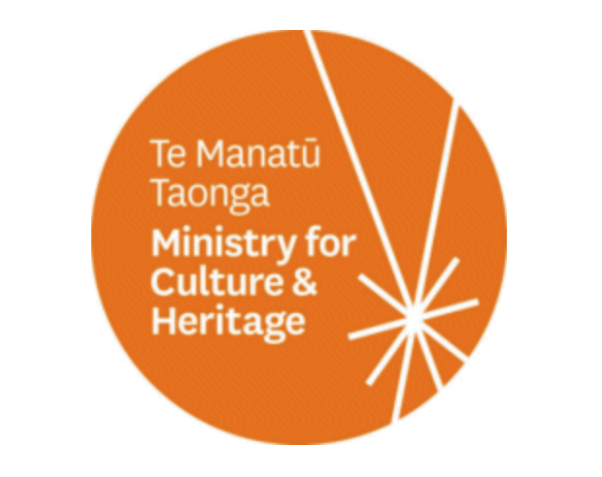
Tohu Whenua is a partnership between
with support from
Team Tohu Whenua
Programme Manager I Contractors I Delivery in the regions
Notes:
Who runs Tohu Whenua?
Tohu Whenua is a partnership between Heritage New Zealand Pouhere Taonga, Department of Conservation Te Papa Atawhai and Manatū Taonga with support from the Ministry of Business, Innovation and Employment and Te Puni Kokiri Ministry of Māori Development. Senior staff from these agencies make up the Tohu Whenua Governance Group.
At a working level, a Steering Group with members from HNZPT, DOC, MCH and TPK oversees operations. The programme employs one permanent staff member, programme manager Caroline Toplis, regional coordinators and contractors on an as-needs basis.

Slide 5
Tohu Whenua are
Publicly, privately and iwi owned places that are:
Significant to Aotearoa New Zealand’s story
High quality visitor experiences
Supported by iwi and communities
Publicly accessible sites presented well in partnership with willing owners
Notes:
Who decides which places are included in the programme?
The Tohu Whenua programme works closely with iwi and communities to identify the places that are most significant to their rohe.
Nominations are assessed against the programme’s criteria: the site is significant to Aotearoa New Zealand’s story, provides a great visitor experience, and are publicly accessible sites presented well in partnership with willing owners/operators.
The final selections or approvals are made by the Tohu Whenua Governance Group.
Tohu Whenua are publicly and privately owned. Some are owned/managed by Heritage New Zealand and the Department of Conservation. Others are managed by iwi, trusts, councils or individuals. The important thing is that the sites’ owners/managers are on board.
Day-to-day operation including maintenance and improvements of each Tohu Whenua is up to the owner/operator.

Slide 6
There are currently 25 Tohu Whenua in three regions:
Te Tai Tokerau Northland
Te Tai Poutini West Coast
Otago
Notes:
Where are Tohu Whenua located?
There are currently 25 Tohu Whenua in three regions – Te Tai Tokerau Northland, Otago and Te Tai Poutini West Coast. The goal is to roll out Tohu Whenua in all regions of Aotearoa New Zealand.
Each region has its unique stories.
Te Tai Tokerau Northland - The birth of a bi-cultural nation Northland’s Tohu Whenua, and the interweaving journeys, tell the stories of our beginnings. These are the places where both our Māori and European ancestors arrived, centuries apart, and where their identities were defined.
Otago - The proof of a pioneering nation Otago’s Tohu Whenua are places that tell the stories of our people’s pioneering spirit – some of the cornerstones of our economic and entrepreneurial livelihood.
Te Tai Poutini West Coast - The rise of a resourceful nation The West Coast’s Tohu Whenua tell the stories of the hardships endured for our country’s most prized resources. A region known for its incredible beauty and rich bounty, these are places where our people’s limits were tested and rewarded.

Slide 7
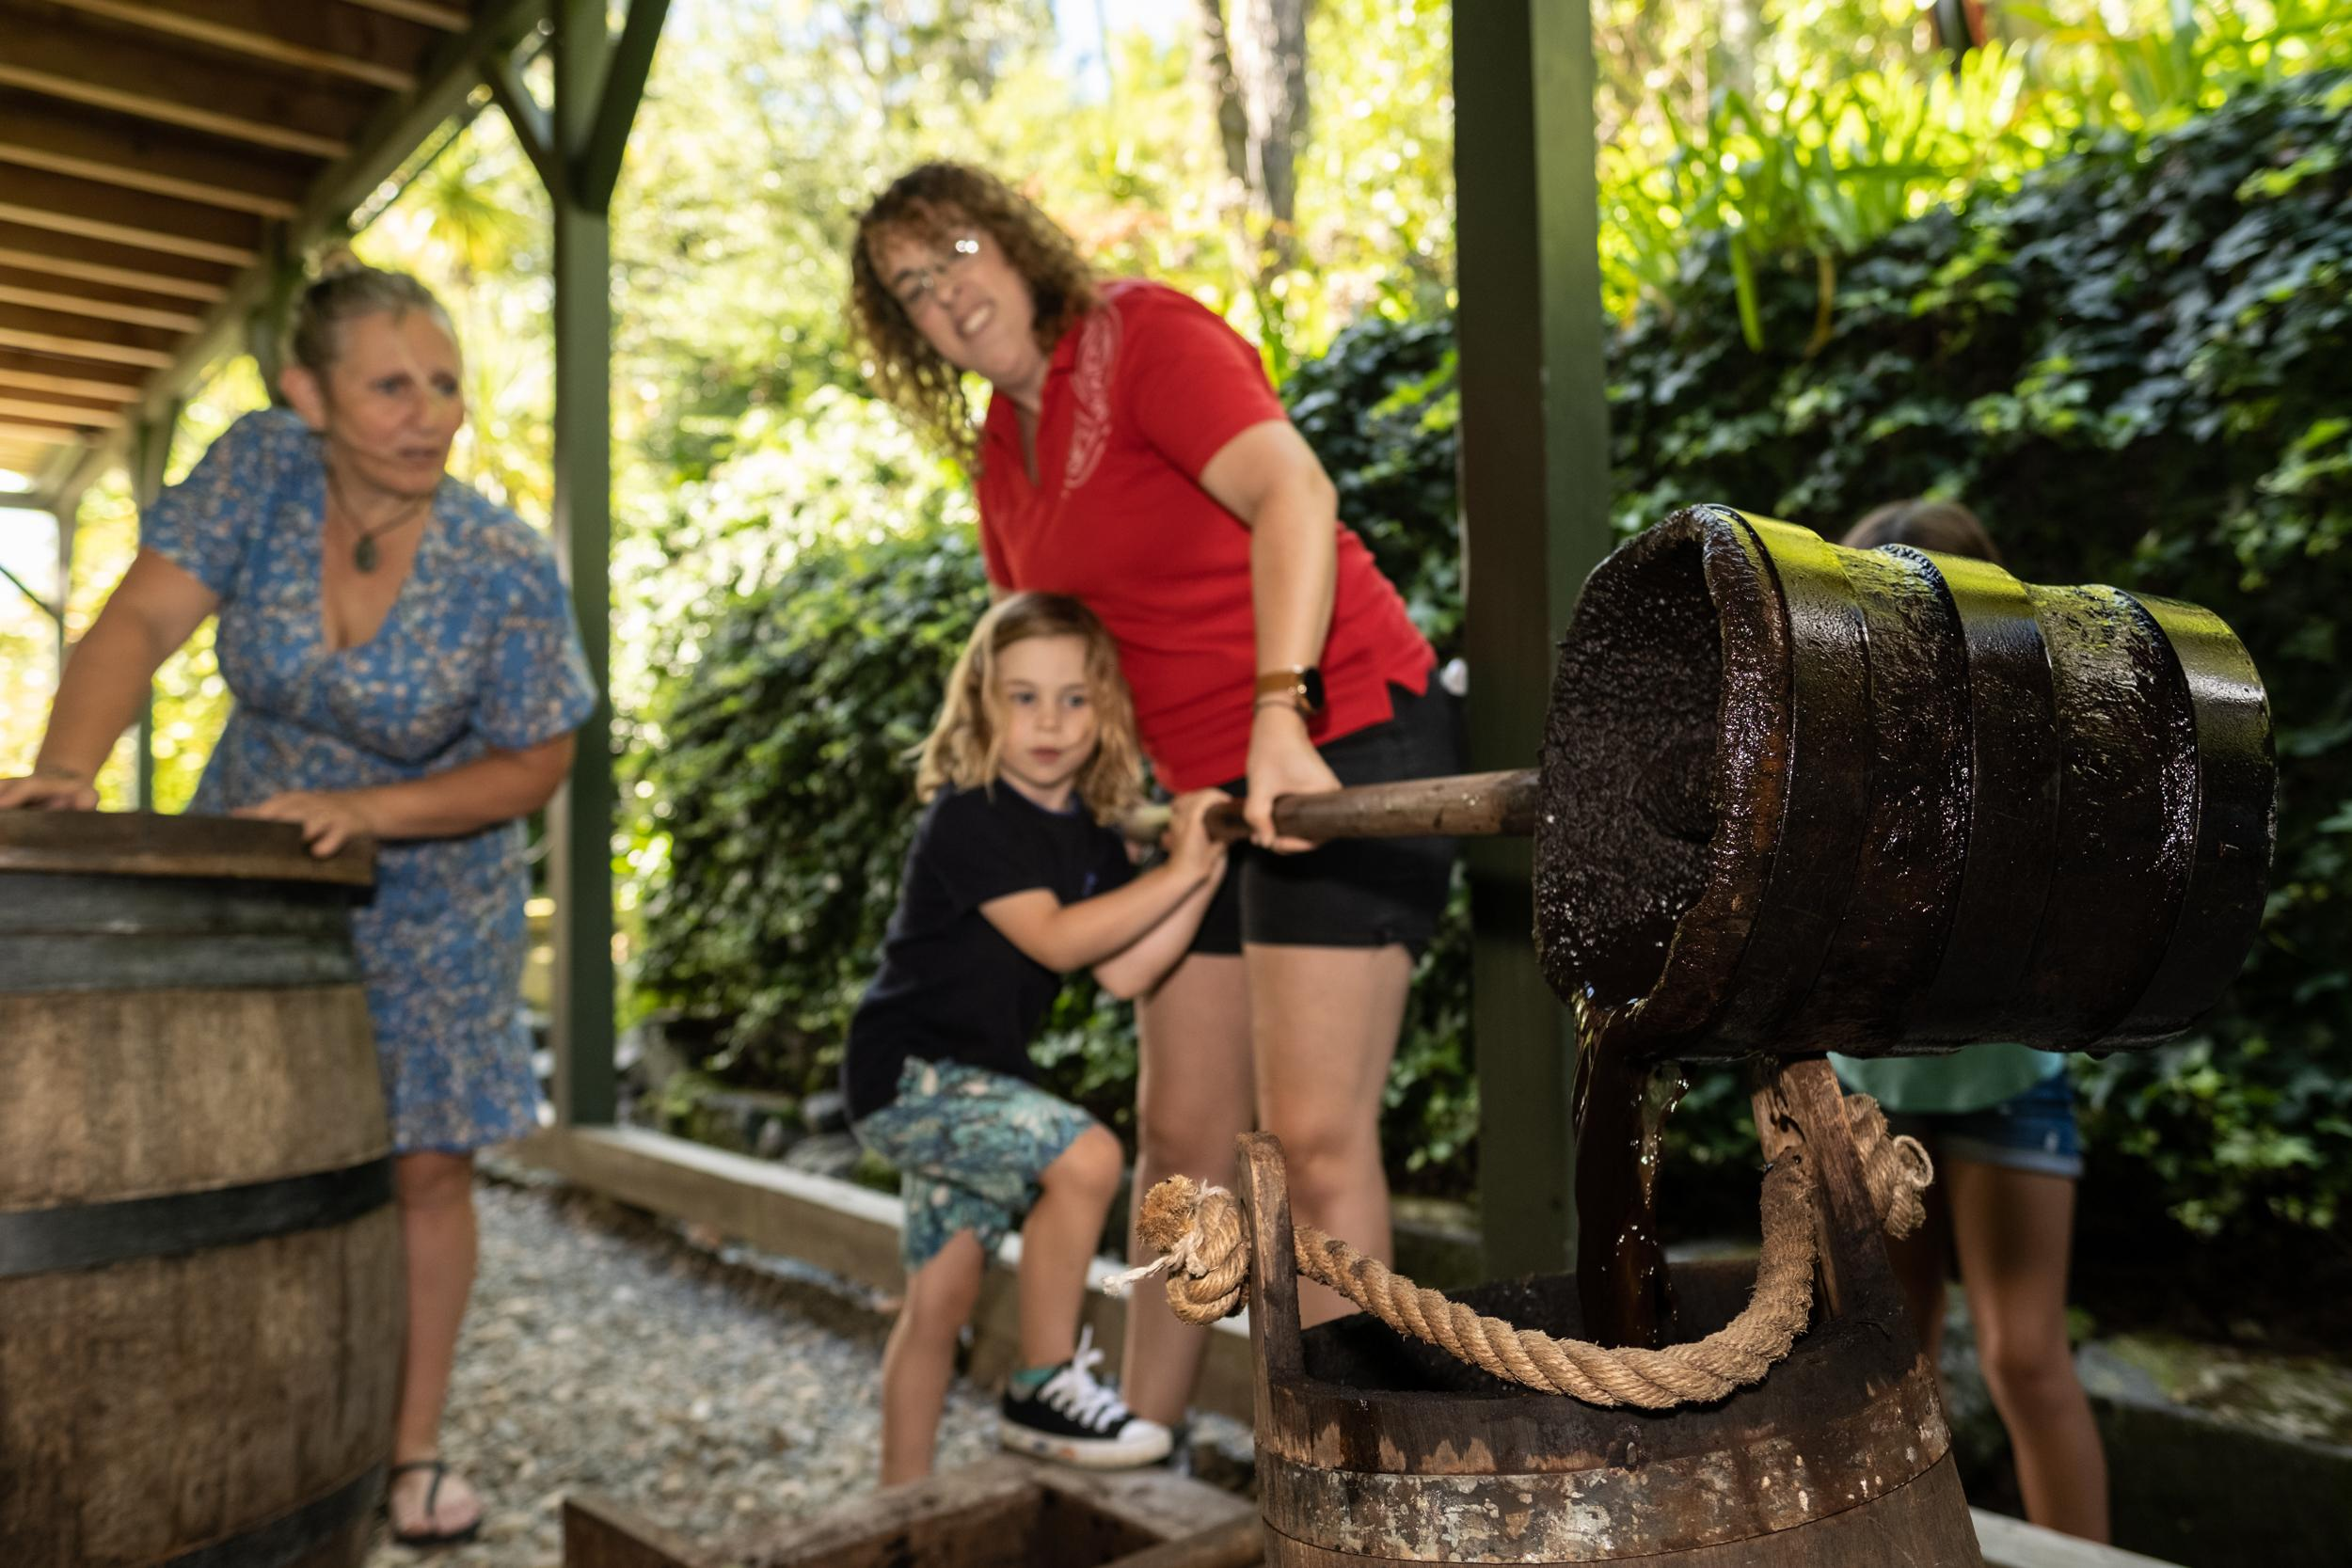
Te Tai Tokerau Northland
9 sites launched in 2016
Ruapekapeka Pā
Pompallier Mission and Printery
Rākaumangamanga Cape Brett
Rangihoua Heritage Park
Kororipo Heritage Park
Waitangi Treaty Grounds
Te Waimate Mission
Māngungu Mission
Clendon House
Notes:
What are the Tohu Whenua in my area?
TE TAI TOKERAU NORTHLAND DELETE IF IT DOESN’T APPLY
More information about each of these places can be found here: tohuwhenua.nz

Slide 8
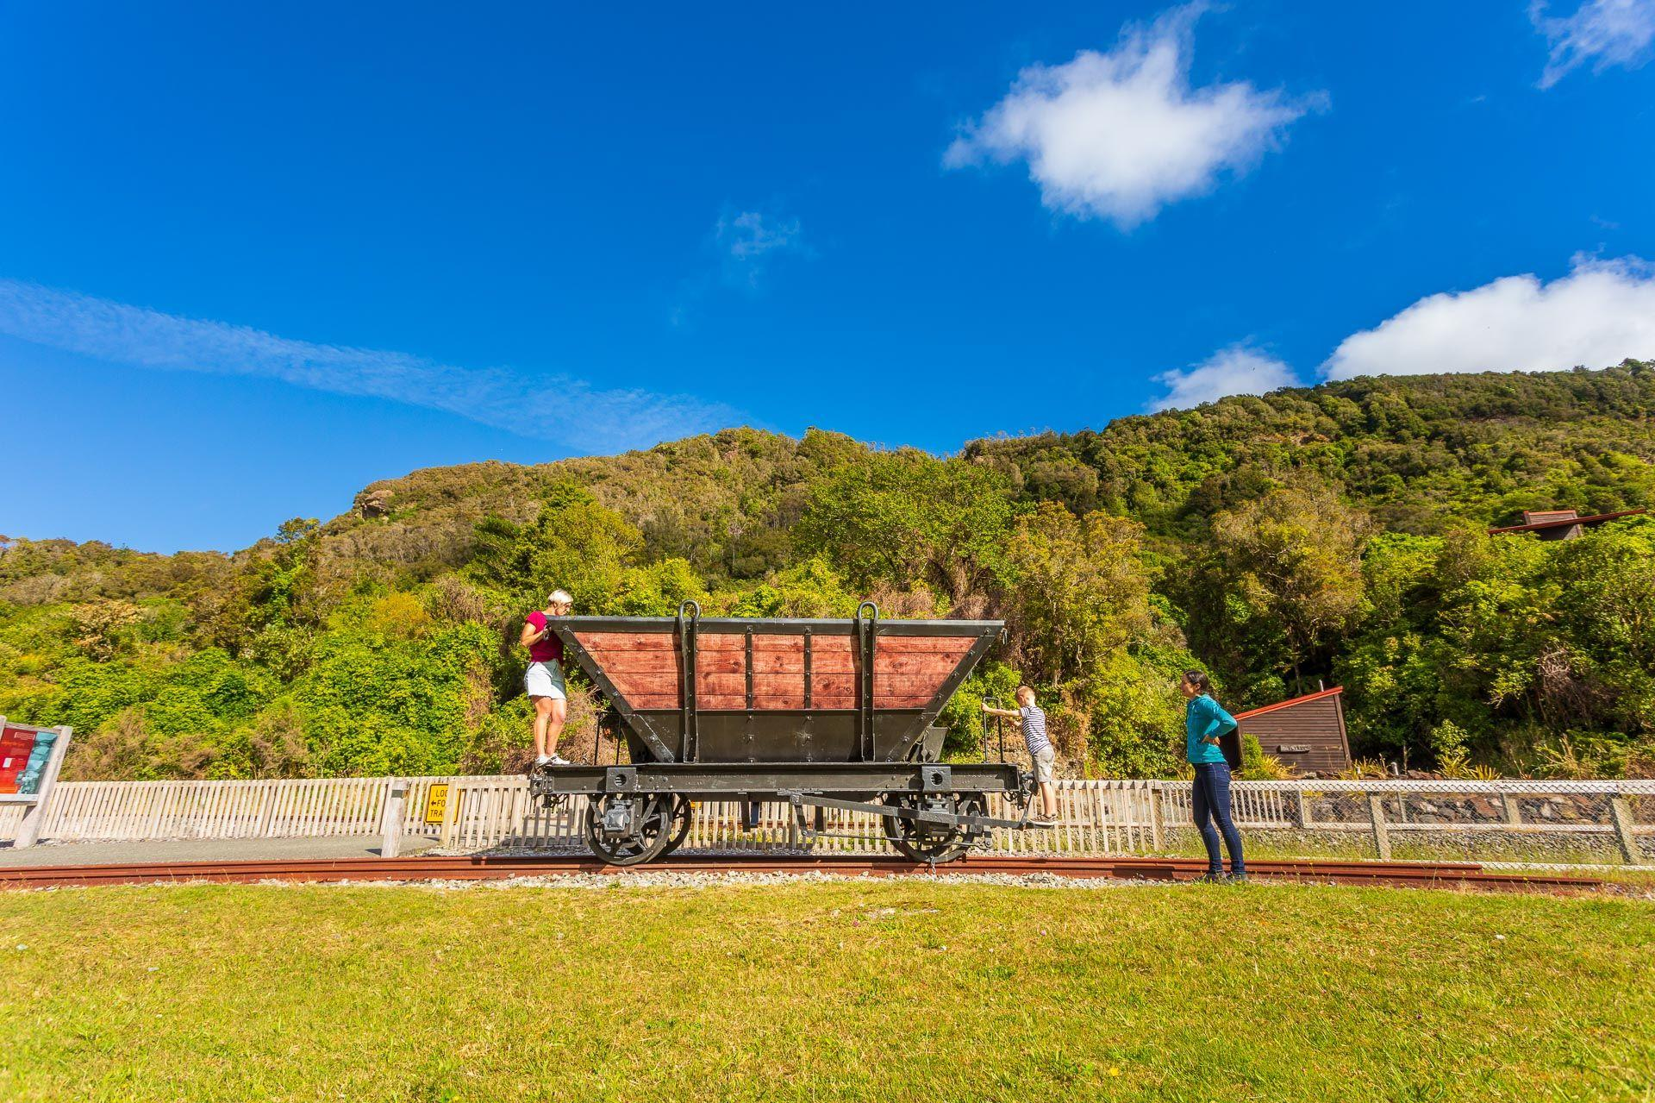
Te Tai Poutini West Coast
5 sites launched in 2018 and 2020
Denniston Mine
Historic Reefton
Waiuta
Brunner Mine
Hokitika Port, Commercial and Government Centre
Notes:
What are the Tohu Whenua in my area?
TE TAI POUTINI DELETE IF IT DOESN’T APPLY
More information about each of these places can be found here: tohuwhenua.nz

Slide 9
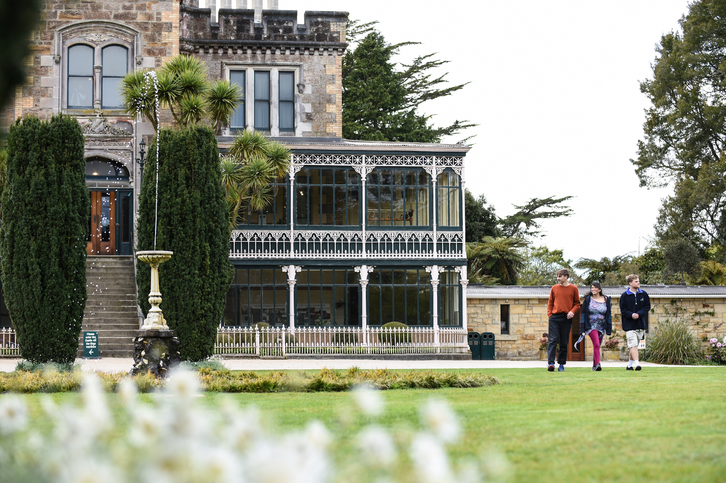
Otago
12 sites launched in 2017
TSS Earnslaw
Arrowtown
Kawarau Suspension Bridge
Bannockburn Sluicings
Otago Central Rail Trail
Hayes Engineering Works
Historic Ōamaru
Totara Estate
Dunedin Railway Station
Olveston
Larnach Castle
Taieri Gorge Railway*
Notes:
What are the Tohu Whenua in my area?
OTAGO DELETE IF IT DOESN’T APPLY
More information about each of these places can be found here: tohuwhenua.nz

Slide 10
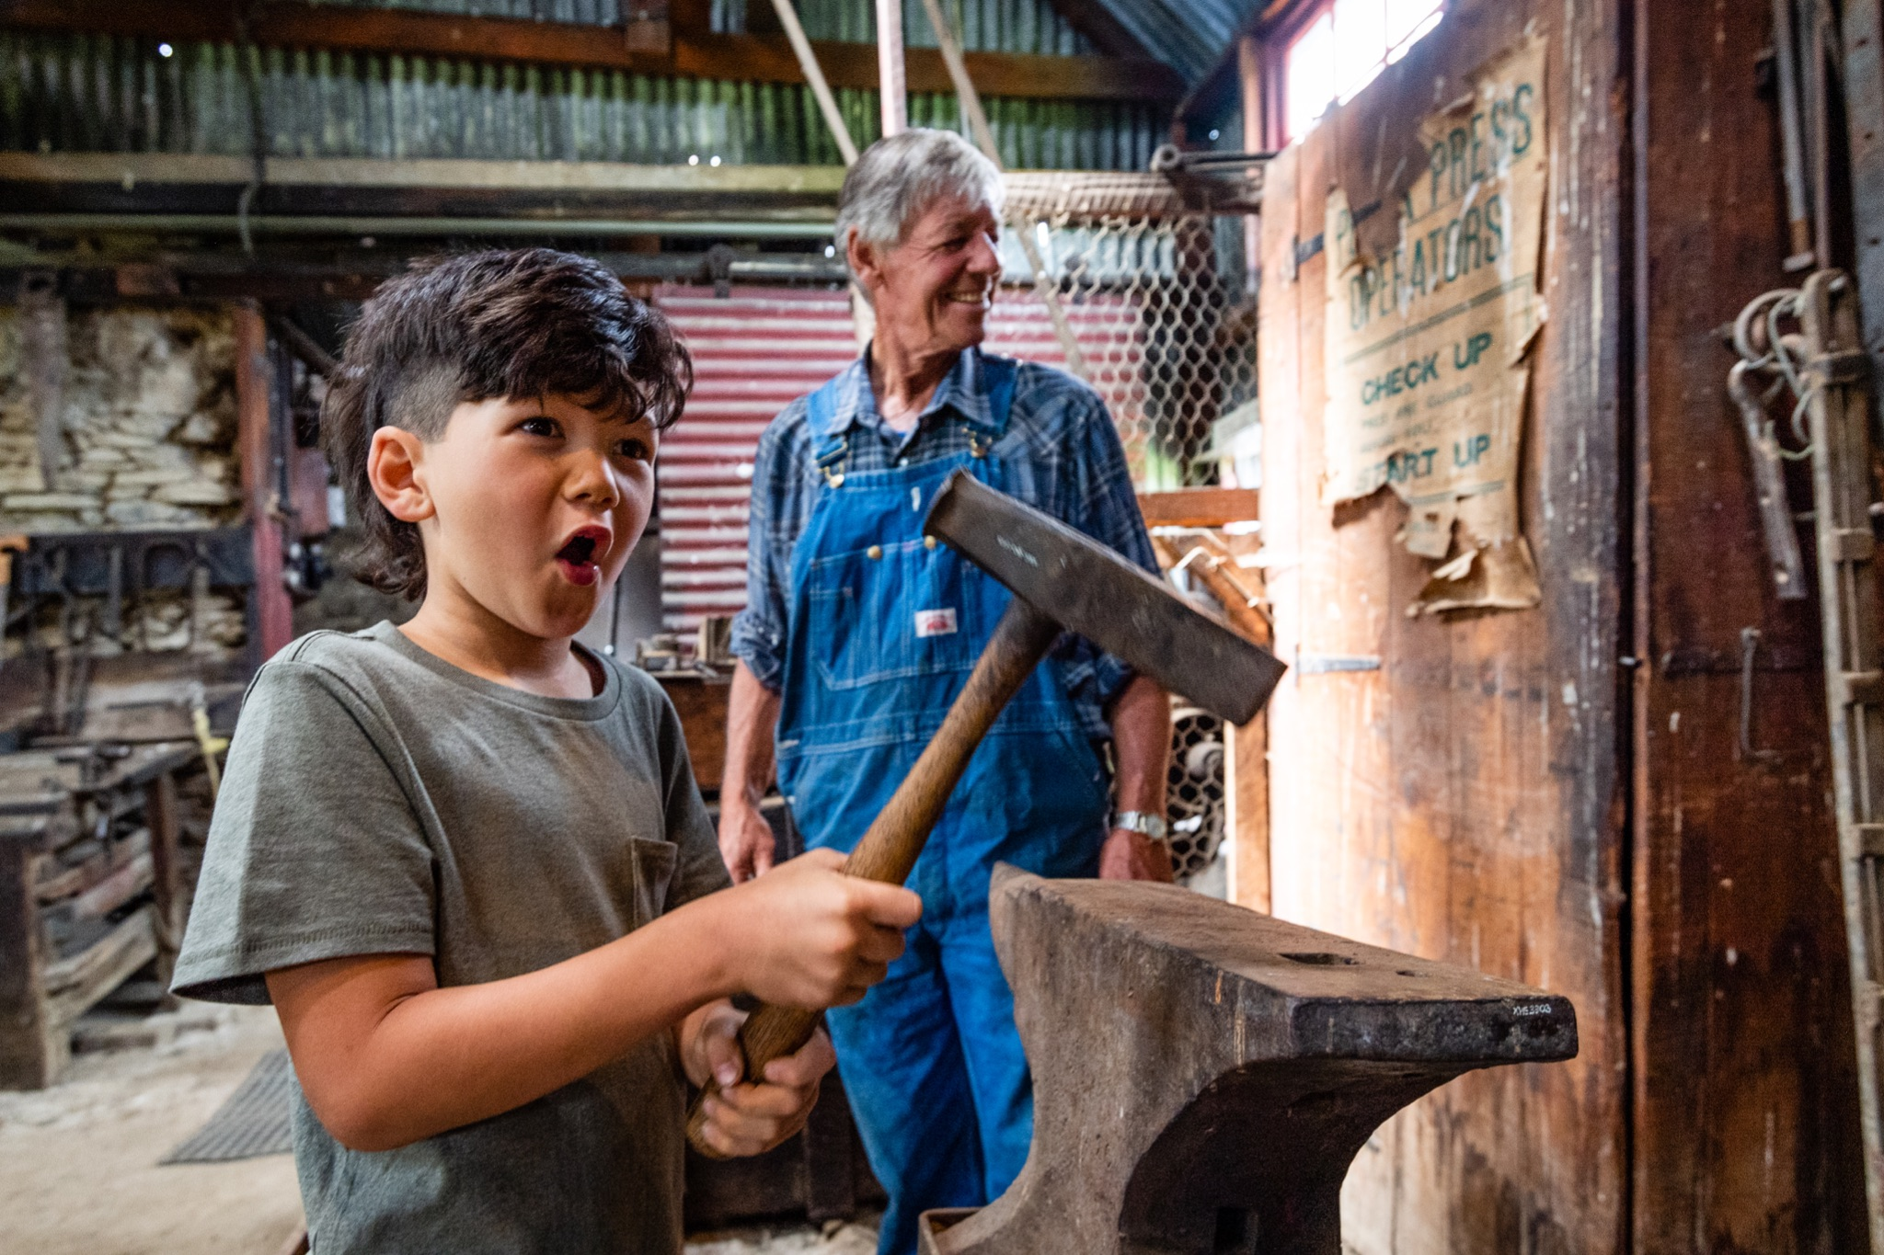
The strength of the Tohu Whenua brand relies on all of us.
Show others you are proud to be part of the Tohu Whenua brand: use the logo, display our flag & banners, promote the website, wear the t-shirt, tag @tohuwhenua
Tell your visitors about other Tohu Whenua. Give them a brochure.
Talk to the team at Tohu Whenua.
Notes:
How can I help?
The strength of the Tohu Whenua brand relies on all of us. Make the Tohu Whenua brand work for you and your region by:
showing others you are proud to be part of the Tohu Whenua brand. Use the logo on your signage, advertising, on your website and email signature. Fly the Tohu Whenua flag. Tag @tohuwhenua in your social media posts.
being a connector and paying it forward. Tell your visitors about the Tohu Whenua in your area or in other regions. Give them a Tohu Whenua brochure.
talking to us. If there is something you need, you have feedback, or you have a great idea for the Tohu Whenua brand, let us know.

Slide 11
Tohu Whenua contacts
Website: tohuwhenua.nz
Facebook and Instagram: @tohuwhenua
Regional lead: insert contact details
Programme manager: Caroline Toplis
ctoplis@heritage.org.nz | 027 642 5592
Marketing & Comms: Claudia Babirat
tohuwhenua@gmail.com | 027 4199 566
Notes:
Who do I contact if I have a question?
The main contact for Tohu Whenua is Caroline Toplis, Programme Manager | based at HNZPT in Wellington | ctoplis@heritage.org.nz | 04 494 8044 | 027 642 5592
Current regional coordinators (part-time):
Te Tai Poutini West Coast: Jose Watson | based in Hokitika | jwatson@heritage.org.nz | 027 281 4085
Otago: Jill Mitchell-Larrivee | based in Dunedin | jmitchell@heritage.org.nz | 027 310 0697
Te Tai Poutini: currently no lead, please contact Caroline Toplis
For marketing, communications, social media and our e-newsletter, contact Claudia Babirat tohuwhenua@gmail.com
Where do I send visitors for more information about Tohu Whenua?
Website: tohuwhenua.nz
Social media: We are active on Facebook and Instagram

